Slide 1


P O R T F O L I O
AutoCAD
Inventor
3DPrinting

Slide 2

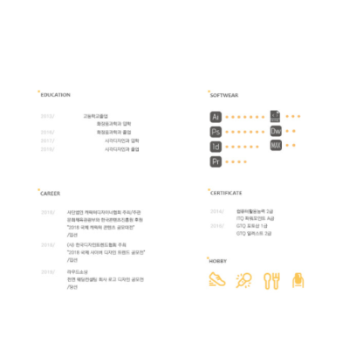

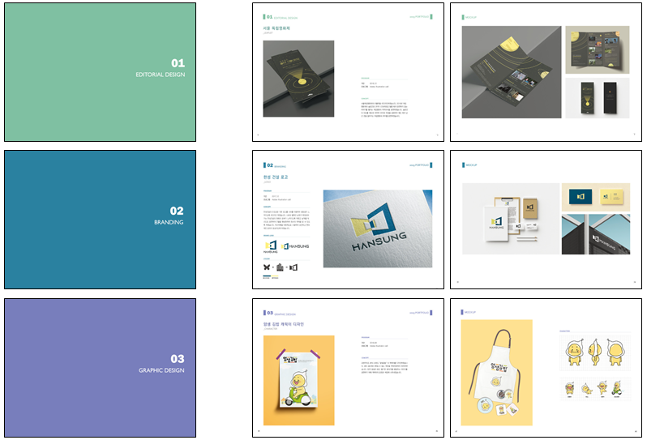

Slide 3
AutoCAD
01

